Slide 1
Installation Instructions for Windows

Slide 2
Installing Anaconda

Slide 3
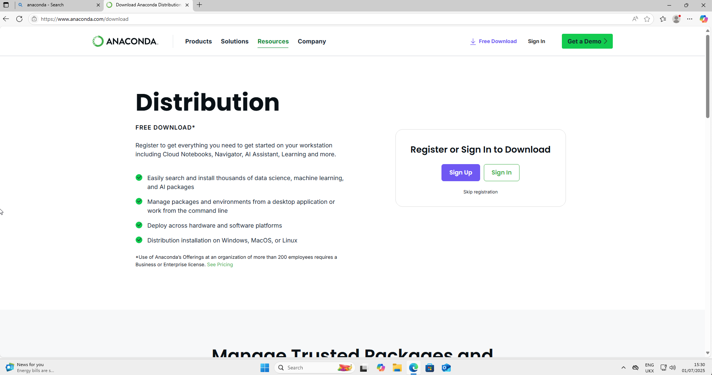
Go to https://www.anaconda.com/download

Slide 4
Click on ”Skip Registration” (as shown by the arrow)

Slide 5
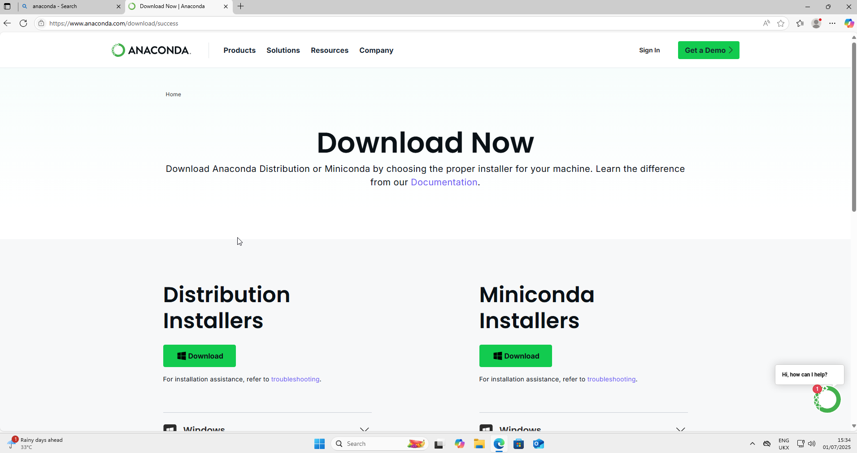
Your screen should now look like this
Click on “Download” on the left (where the arrow is pointing to)

Slide 6
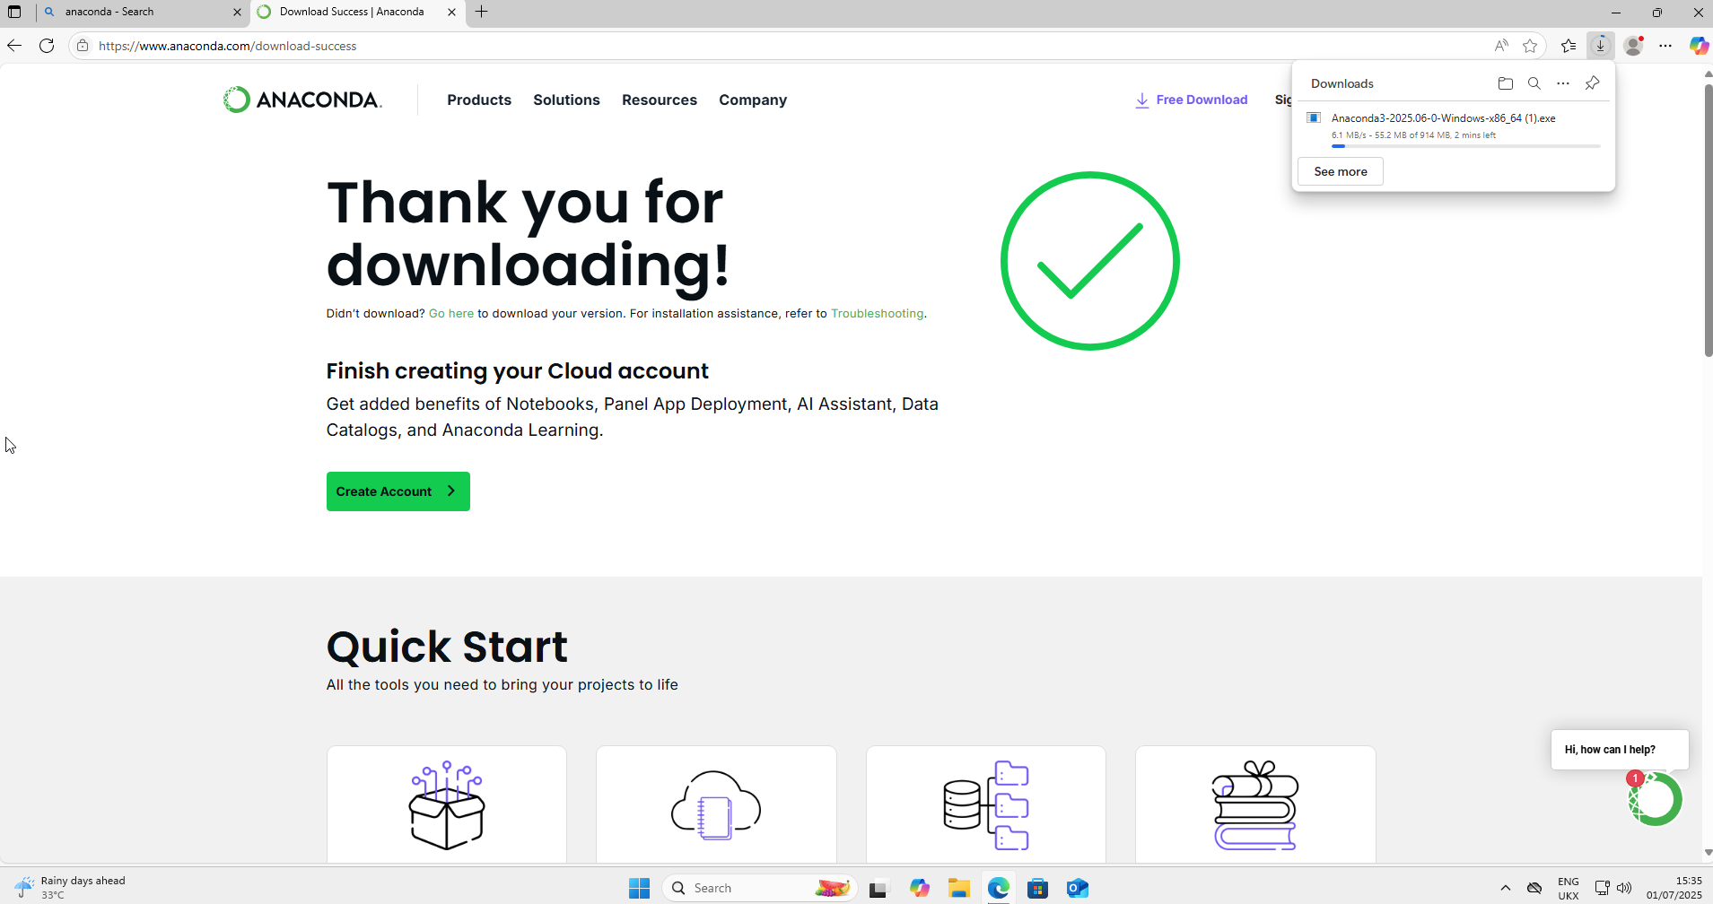
This will open up a Download box in the top right
Wait for the download to complete

Slide 7
Navigate to your “Downloads” folder and find the download

Slide 8
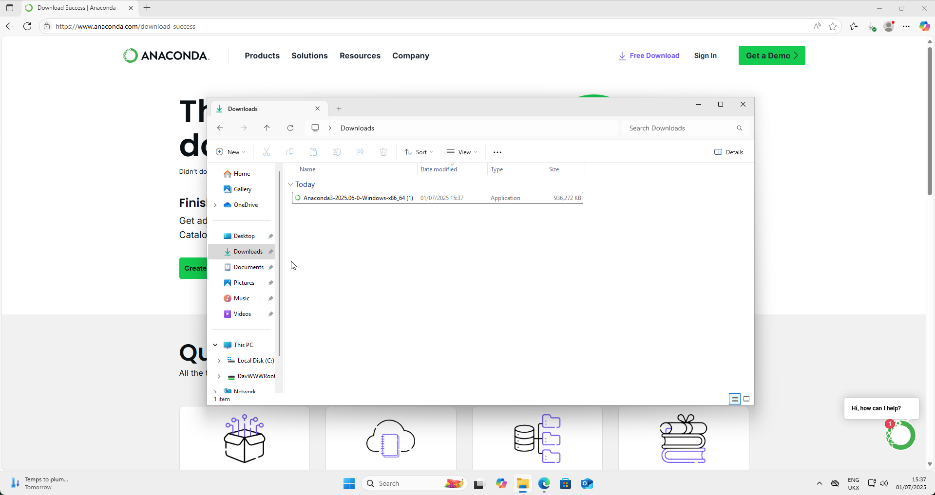
Navigate to your “Downloads” folder and find the download
It should be called “Anaconda3-2025/06-0-Windows-x86_64
Click on this

Slide 9
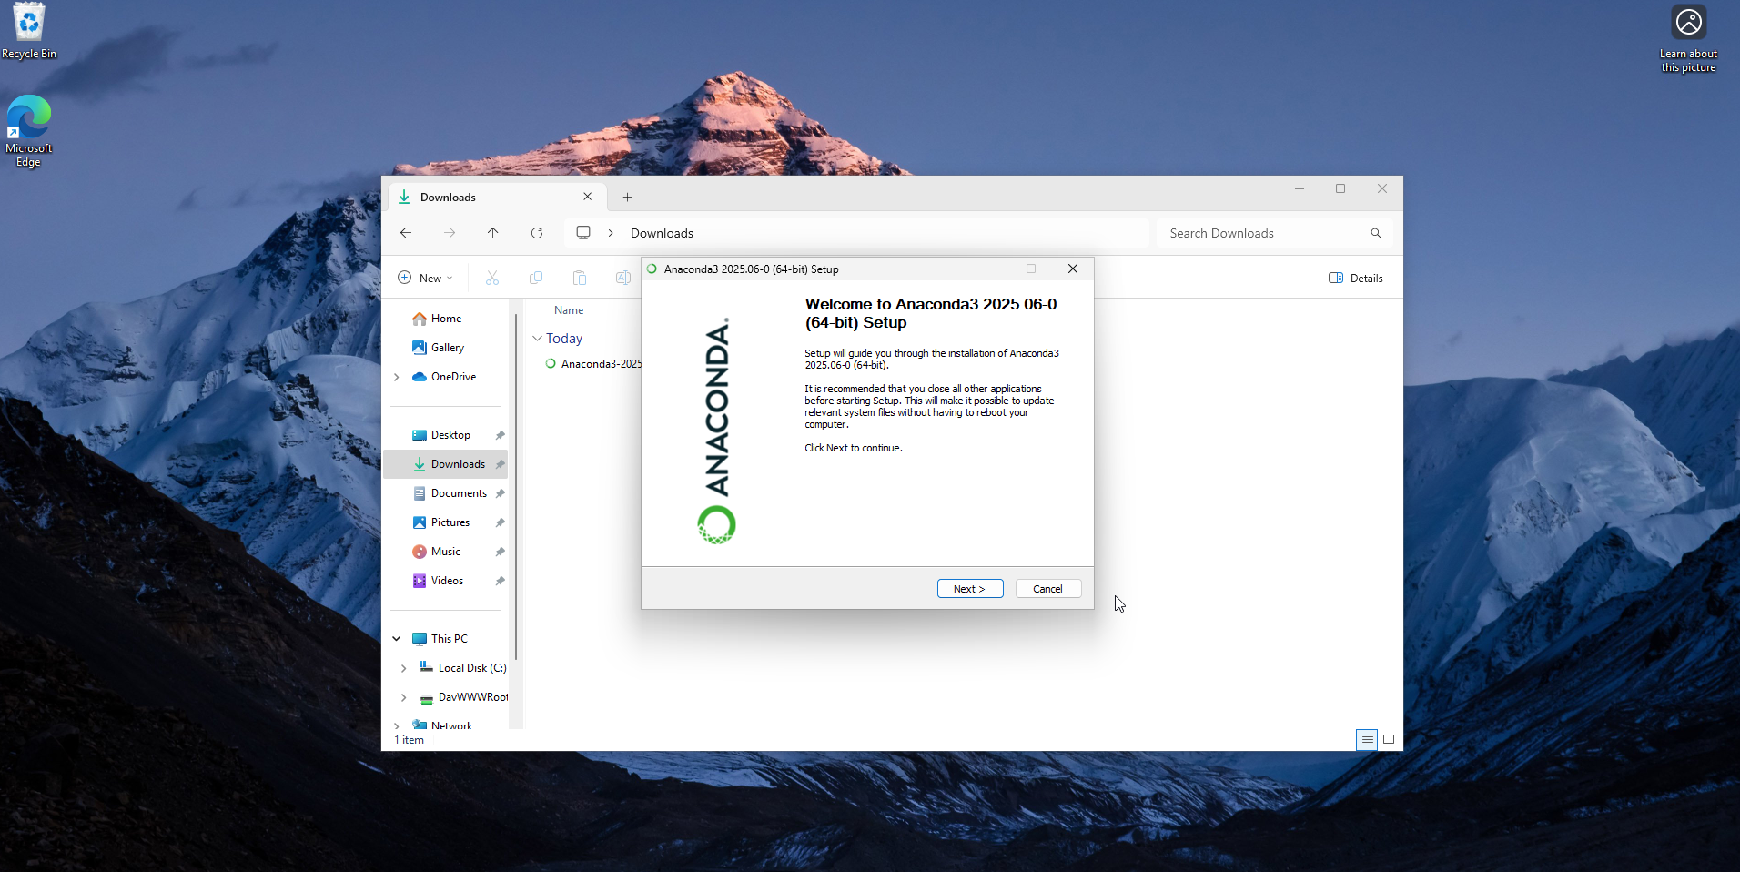
A dialogue box like this should open
Click on “Next”

Slide 10
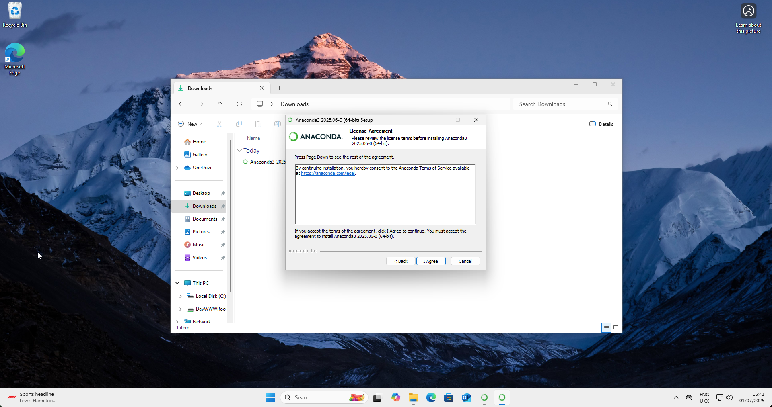
You will be asked if you agree to the License Agreement
Click “I Agree”

Slide 11
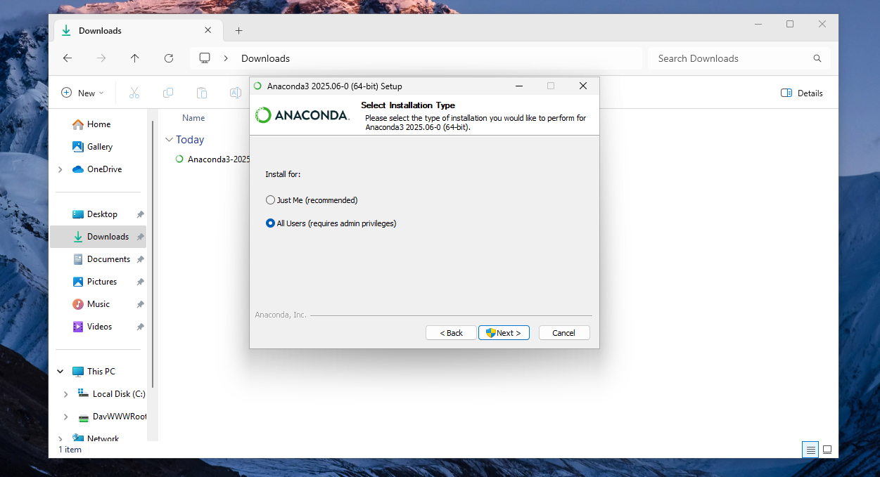
You will be asked to ”Select Installation Type”
Select the bottom option: All Users (requires admin privileges)
Click Next
You may be asked to give your password: this is fine, you can enter it

Slide 12

You will be asked to “Choose Install Location”
It is IMPORTANT that there are no Chinese characters in the “Destination Folder” box, only English characters (where the arrow is pointing)
If there are any Chinese characters, change the name in the box to “C:\Anaconda3\”
There must only be English characters in this box; no Chinese characters

Slide 13
Click Next
There must only be English characters in this box; no Chinese characters

Slide 14
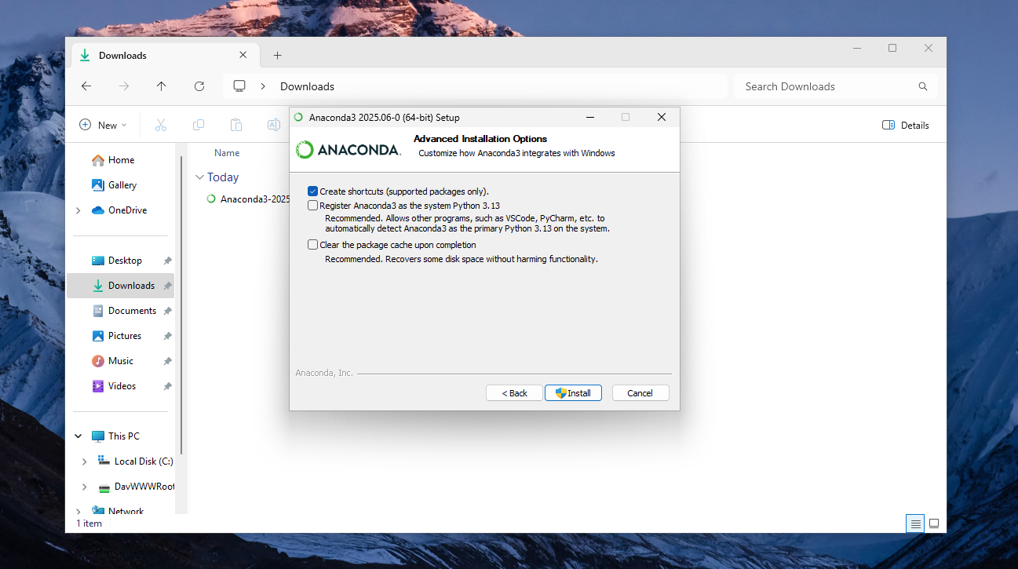
On “Advanced Installation Options”, only select the top box (”Create Shortcuts”)
Click “Install”

Slide 15
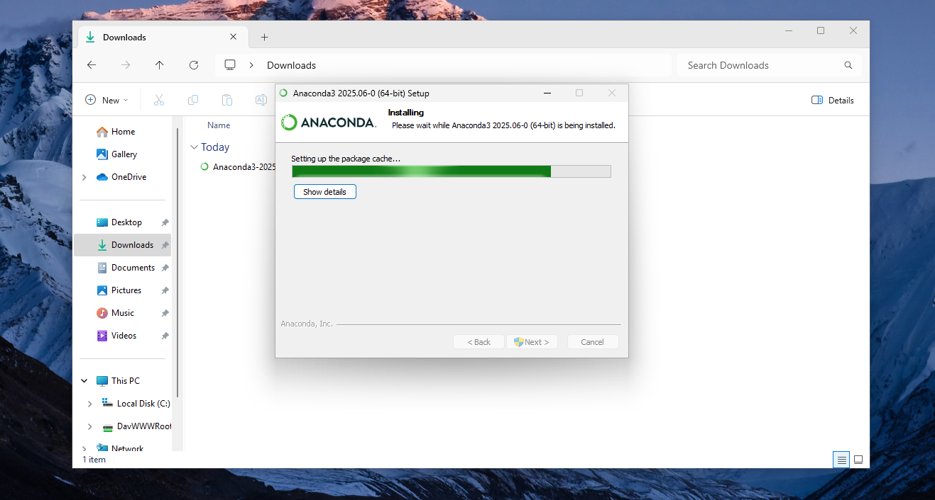
A progress bar will start while installing
You need to wait for it to finish running: it will take a few minutes

Slide 16
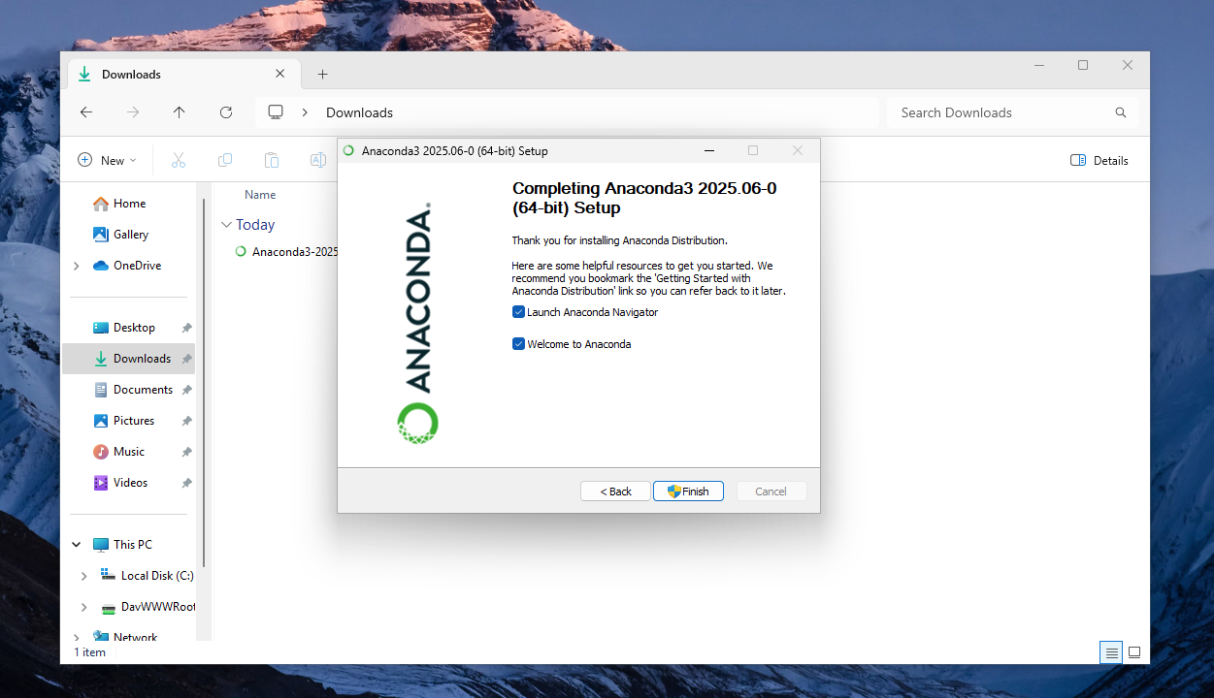
Once the installation has completed, you will be shown this final box
Click “Finish”

Slide 17
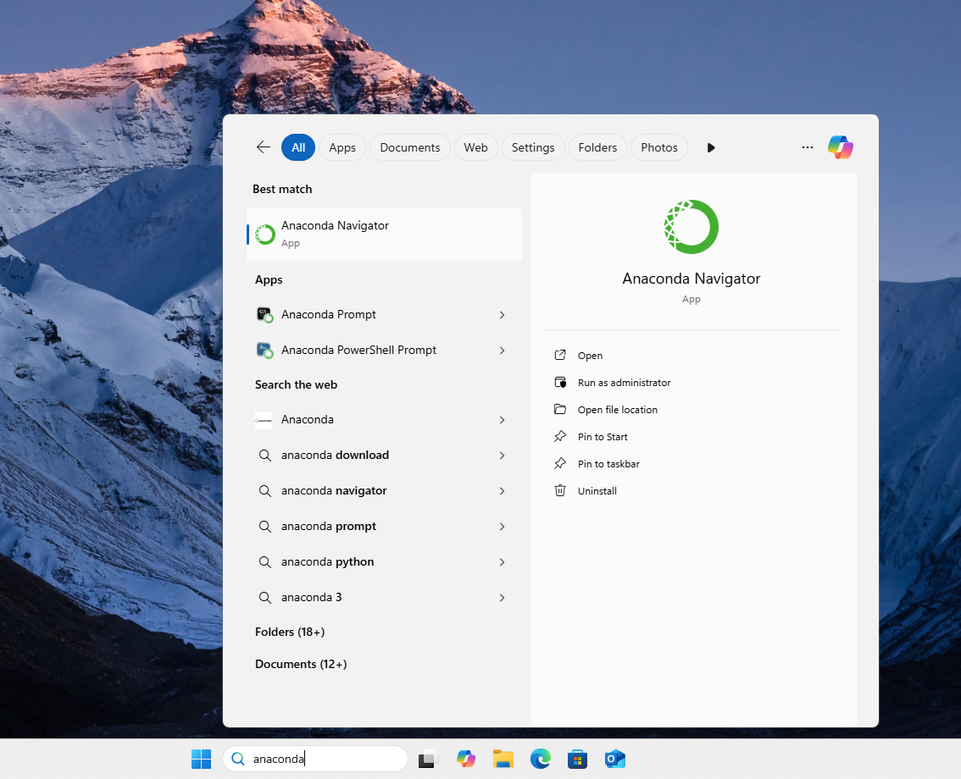
Now, you should have a new program called “Anaconda Navigator” on your computer
Click on it

Slide 18
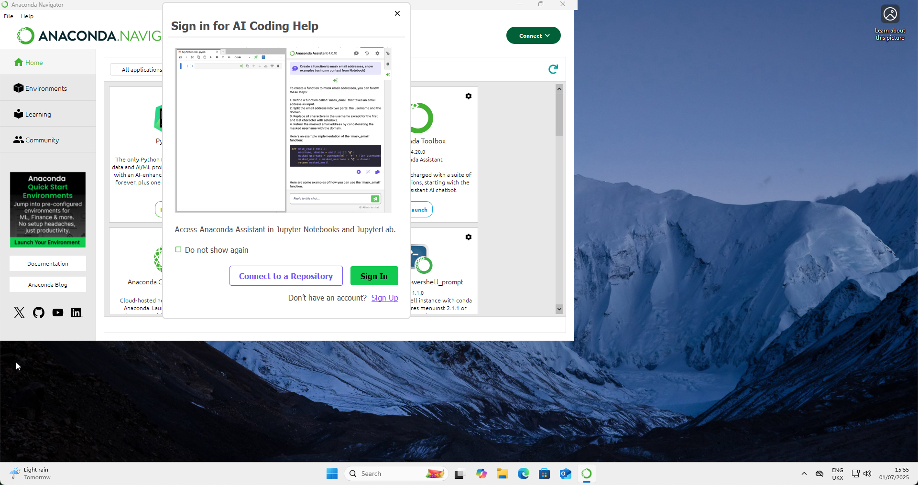
After about 30 seconds, the following window should open
If it does not open at all, go back to the downloads folder and follow the instructions again

Slide 19
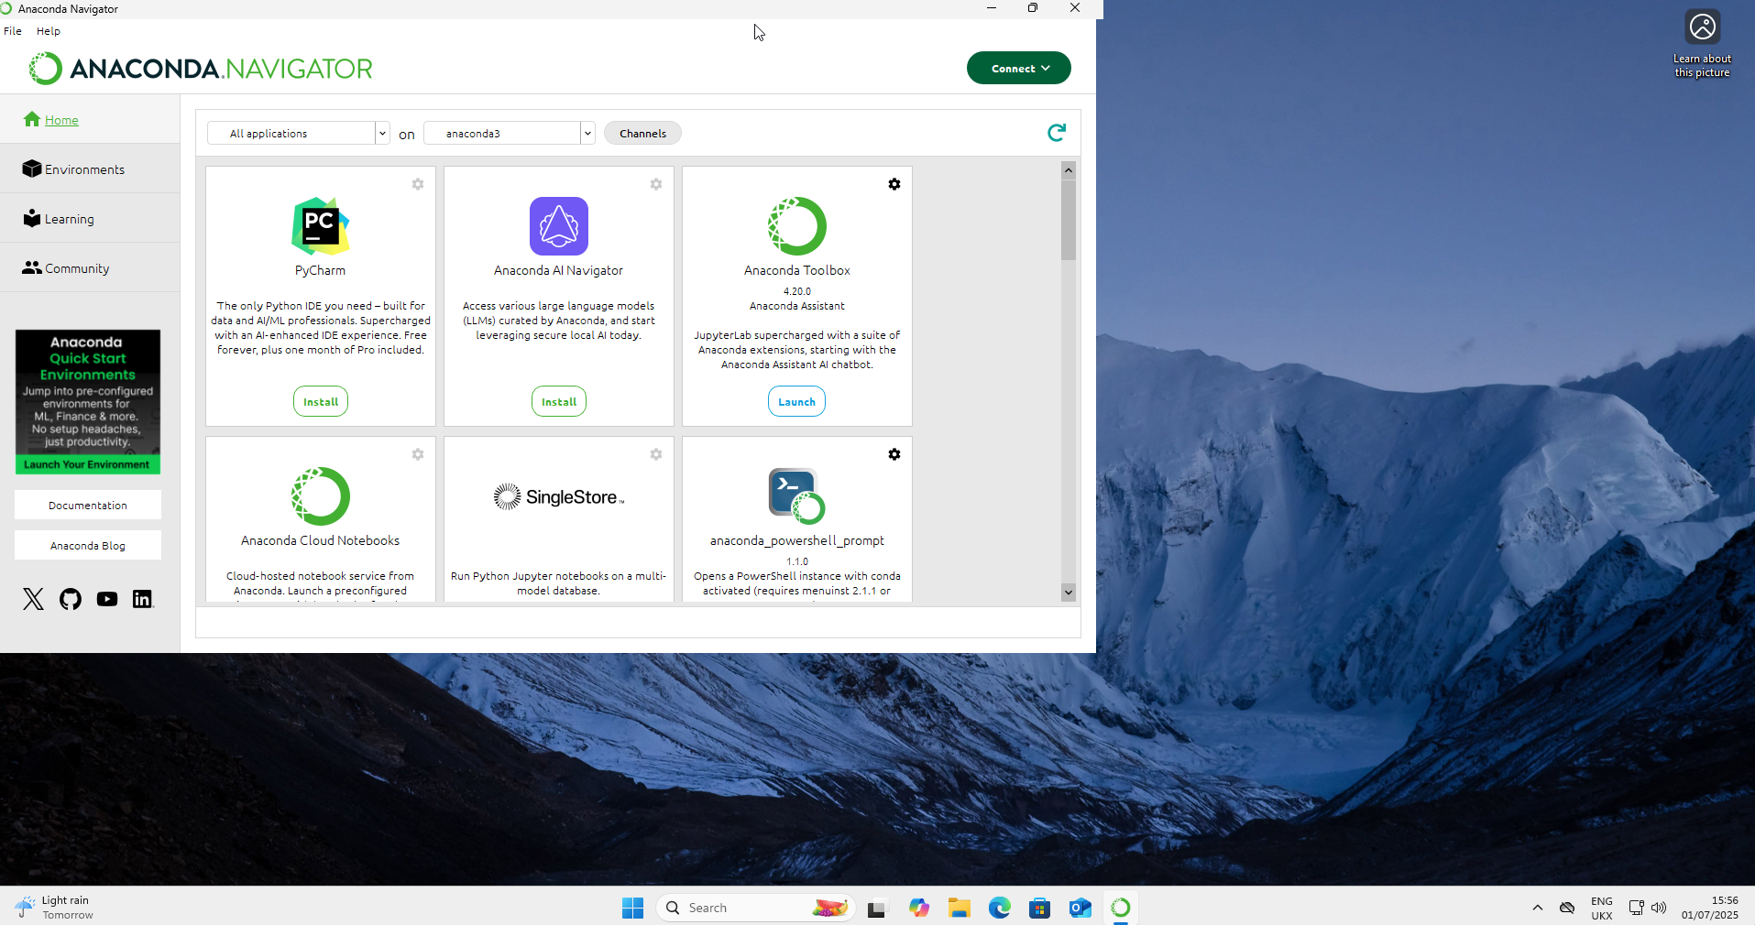
Close the window about “AI Coding Help” if it has appeared for you

Slide 20
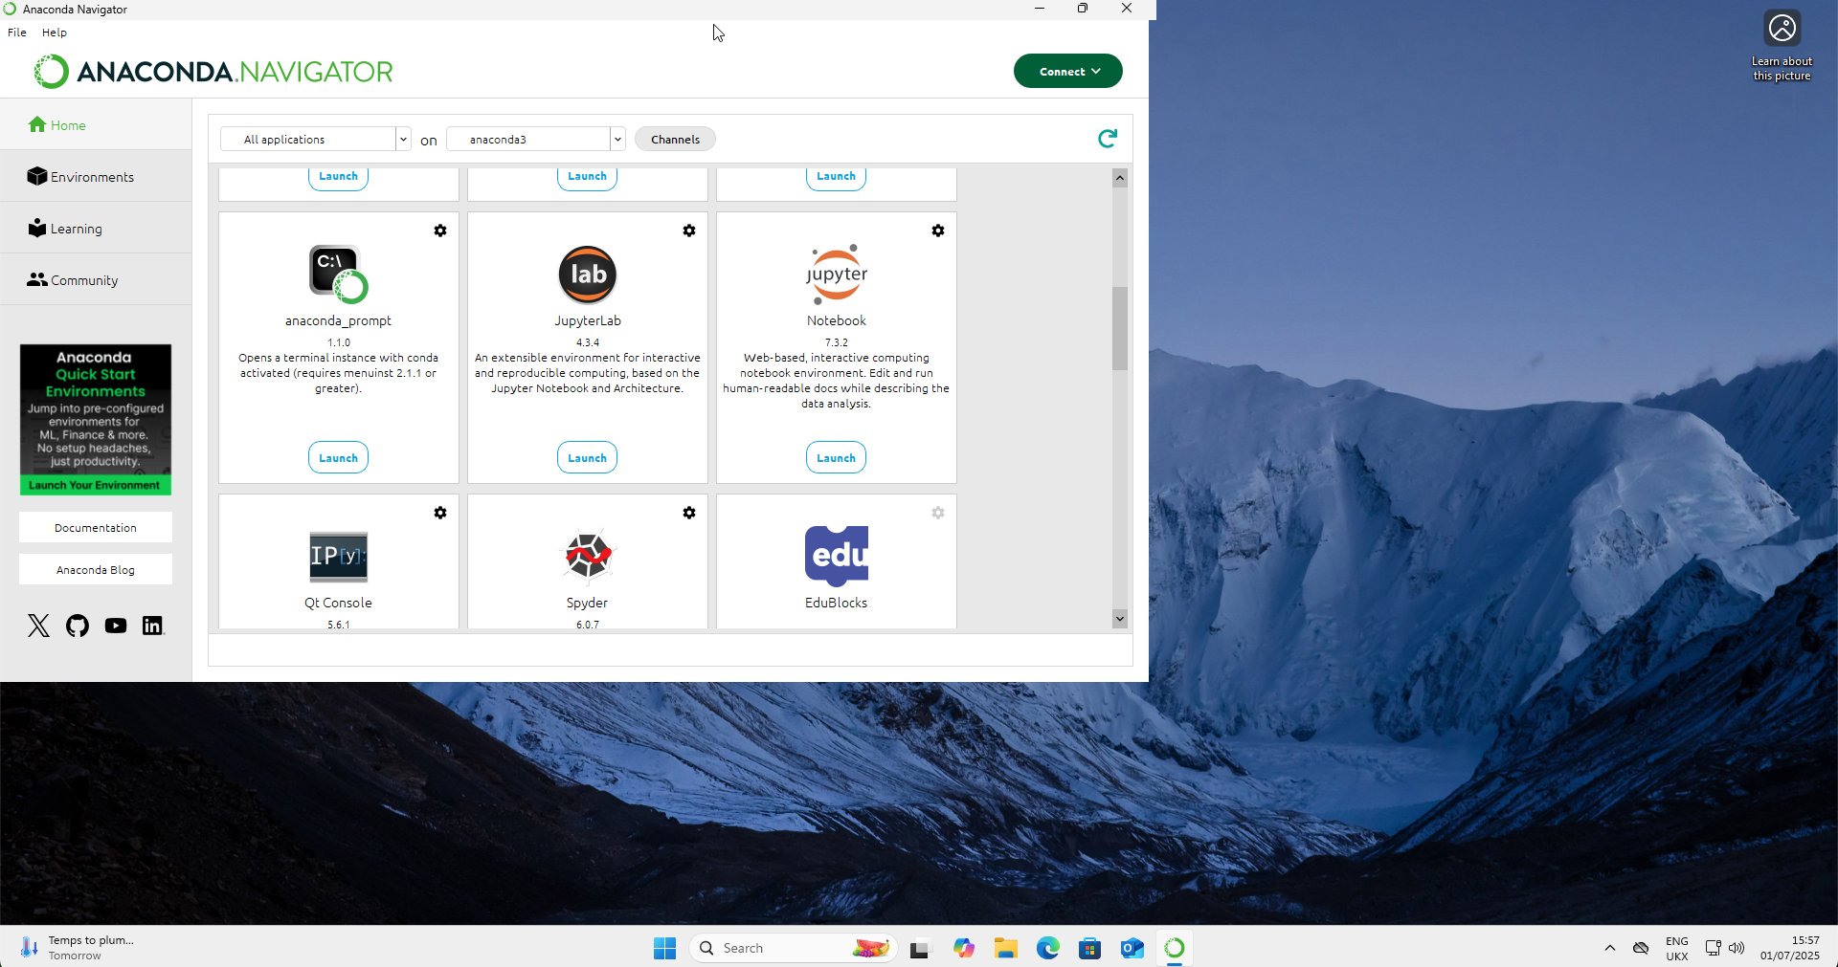
Scroll on the right until you find “JupyterLab”
Click “Launch”

Slide 21
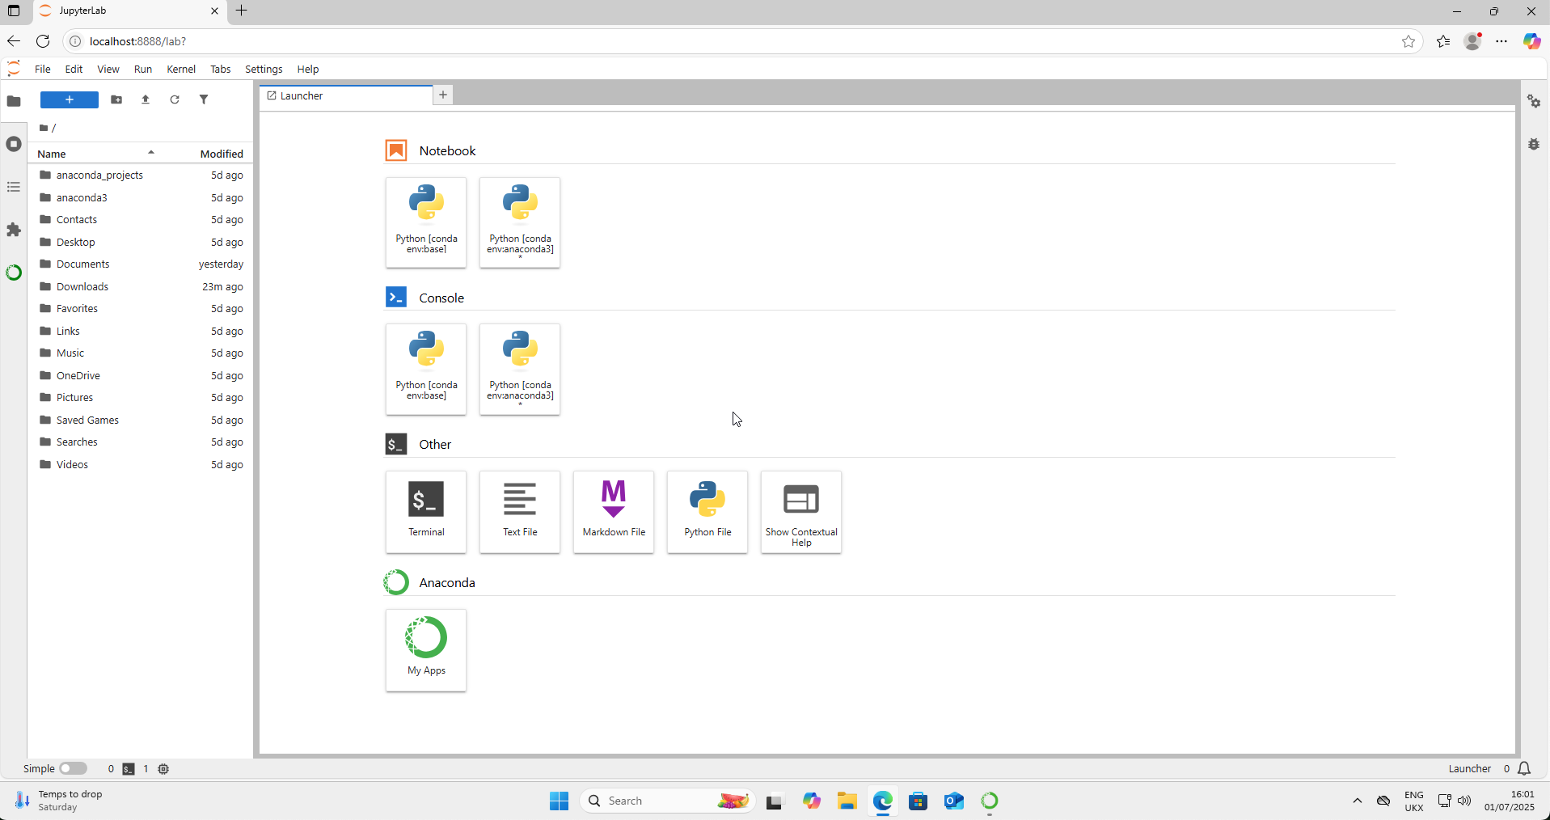
This will open a window in your browser:

Slide 22
If this window does not open, then go back to the start of the installation instructions and follow them again

Slide 23
Downloading Course Materials

Slide 24
Open your browser and go to this URL: https://github.com/griffinfarrow/OXCEP-Precision-Dental-Medicine (for the dentistry course) or https://github.com/griffinfarrow/OXCEP-Precision-Medicine (for the medicine course)

Slide 25
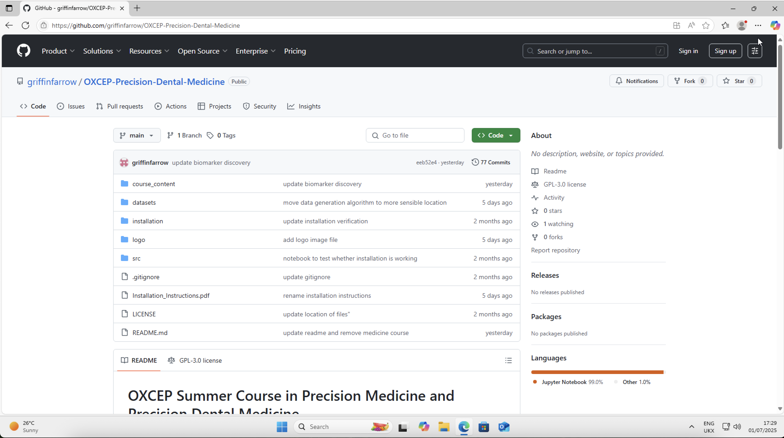
You should see a window like this:

Slide 26
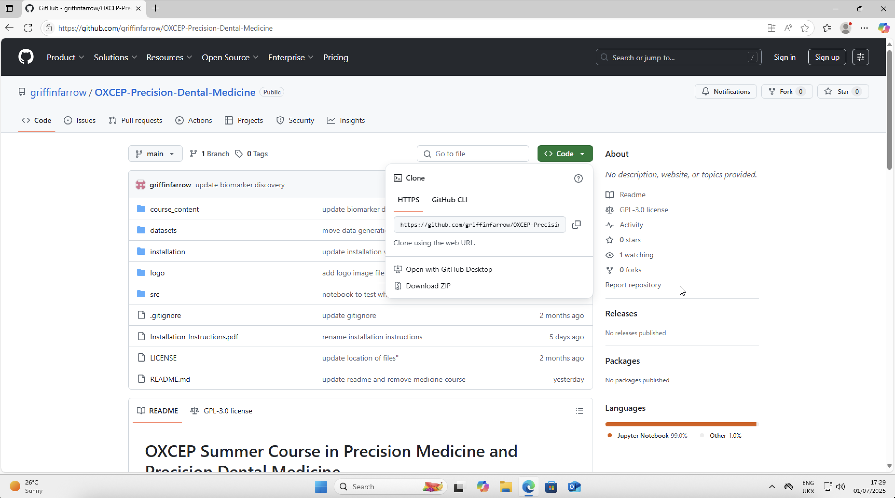
Go to the green “Code” button on the right hand side
Select “Download Zip”

Slide 27
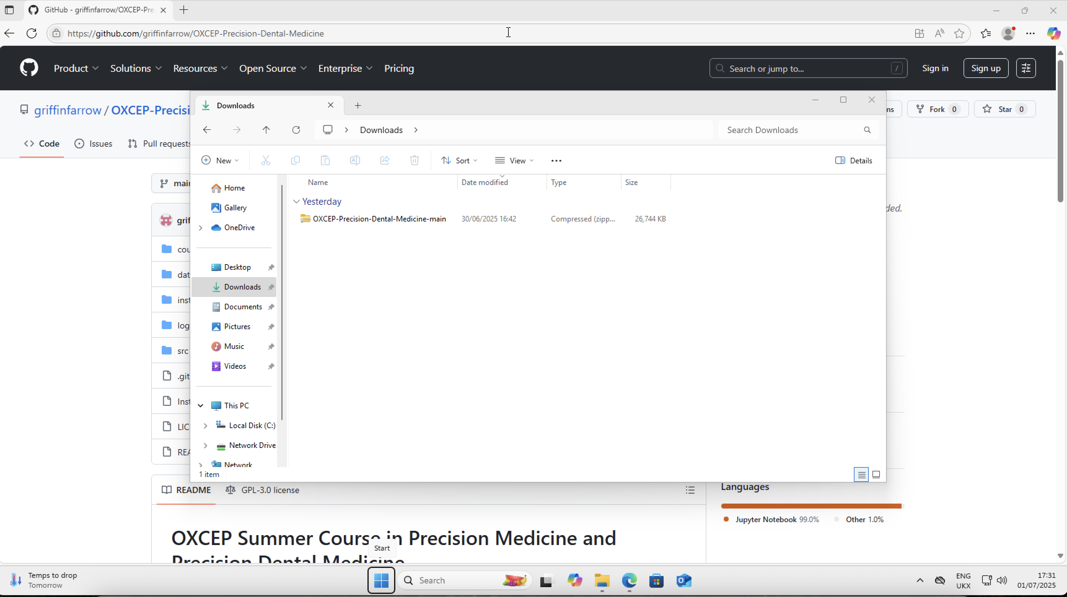
Once the Download has completed, go to your Downloads folder
You should see a “zipped” file

Slide 28
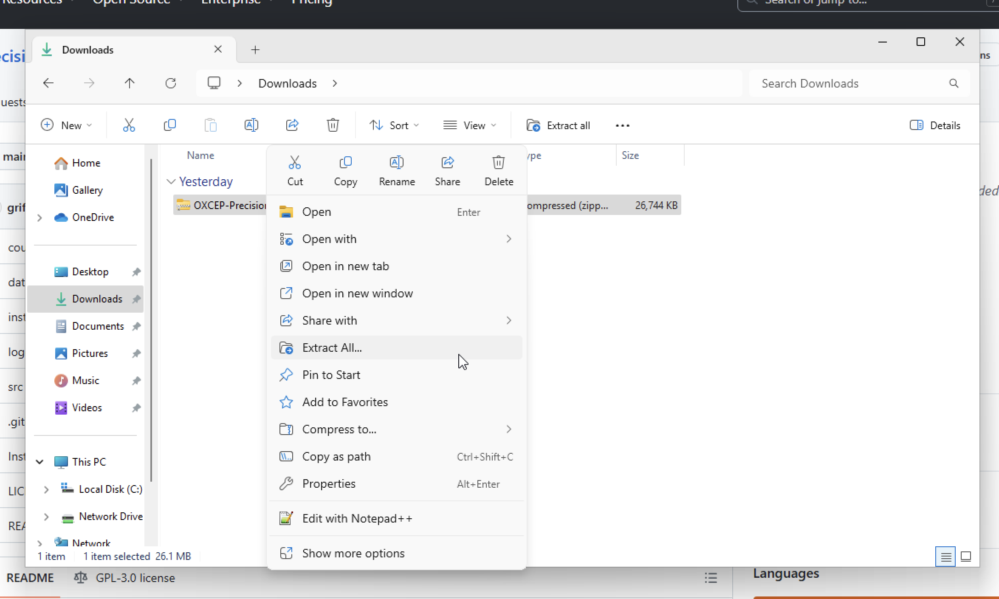
Right click on the zipped object and click “Extract All”

Slide 29
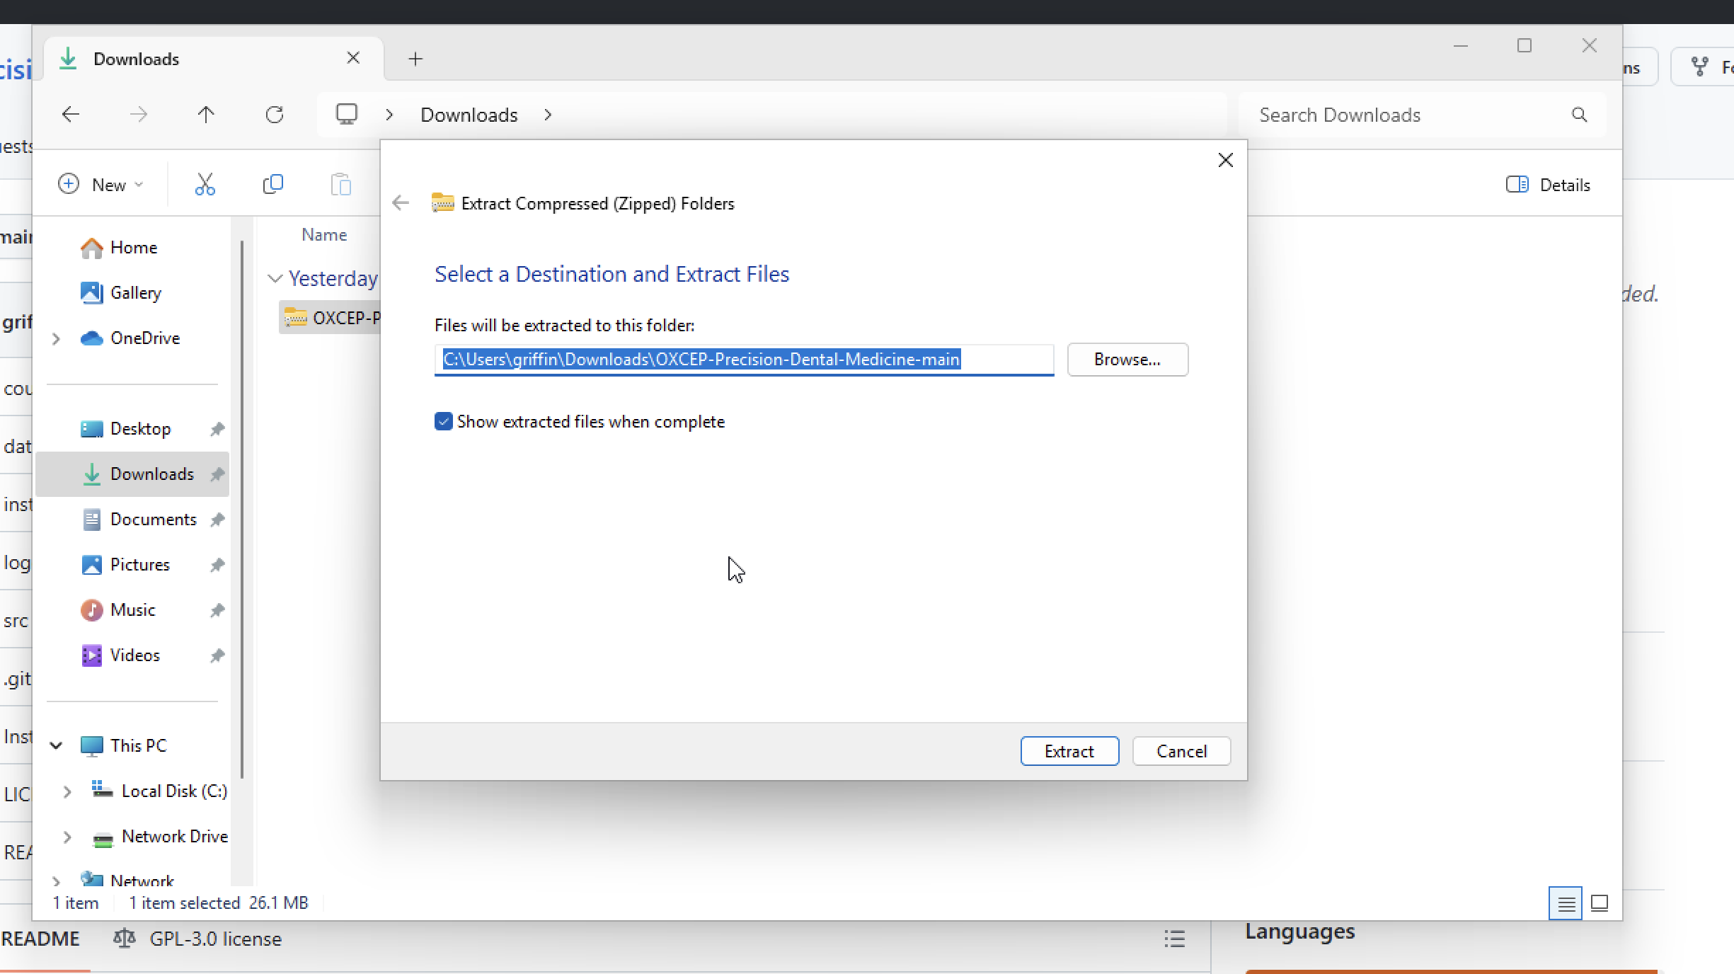
A window will open
Click “Extract”
Again, ensure there are no Chinese characters in the file path

Slide 30
Congratulations! You have finished the installation for the course!

Slide 31
Loading JupyterLab

Slide 32
Open the “Anaconda Navigator” from the Start Menu
Click “Launch” on JupyterLab
You should see a window like the next slide
If you are stuck, slides 17-25 showed how to open JupyterLab

